Slide 1
Lianrui Yang

Slide 2
What is the problem?
In 5G communication system, the number of base-stations in a cell increase significantly which leads to high energy consumption.
Meanwhile, as a kind of nature resources, electromagnetic spectrum is valuable and can be bought, rent, leased.
To lease a spectrum, network operators such as China Mobile, China Unicom have to turning on a base-station and pay for electricity fee.

Slide 3
We need an algorithm to maximize revenue!
Consuming Energy
Leasing Spectrum
-$
+$
Pay money if turning on BSs
Earn money if turning on BSs
An Operator

Slide 4
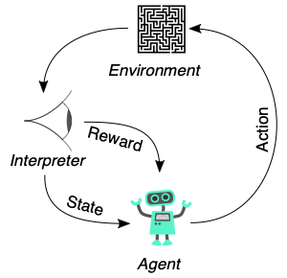
Reinforcement Learning
Reinforcement learning is a technology that Pro. Sajjad and Attai. suggested me to use.
Figure: Principles of Reinforcement learning

Slide 5
In this project, we have 12 base-stations (BSs) and 1008 time slots. Each BS has 2 states (on / off) Each time slot, 12 demand data are generated
Demand data from BSs
Calculate Rewards by P_save and Revenue
Decide which BS need to be turned off

Slide 6
Algorithms
1. Epsilon Greedy (E-greedy)
2. Upper Confidence Bound (UCB)

Slide 7
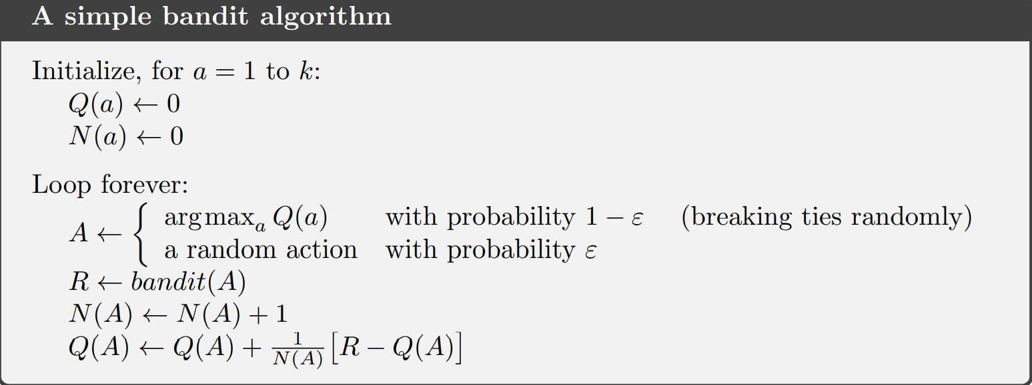
Epsilon Greedy
Action | 1 | 1 | 2 | 3 | 1
N(a) | N(1) = 1 | N(1) = 2 | N(2) = 1 | N(3) = 1 | N(1) = 3
Time

Slide 8
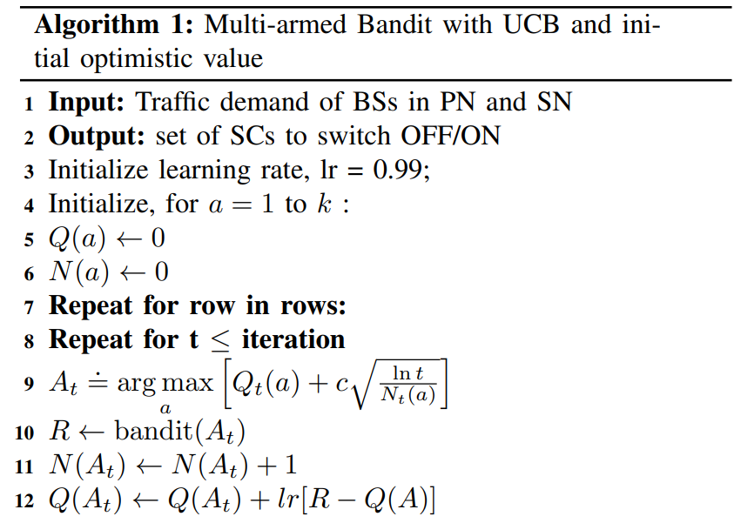
UCB

Slide 9
Limitation
As the number of micro base-stations in a cell increases, the Q table increases exponentially. The whole algorithm may need a large amount time to be execute.

